Slide 1
R Champions
Omar Ahmouda, Leona Bell, Helen Chu, Hoai Do, Delaney Smith
BANA 4080 - Homework 3
Australian Weather Data

Slide 2
Goal
The goal is to create models to predict whether it will rain tomorrow, with the models being flexible enough to potentially apply to places outside of Australia.

Slide 3
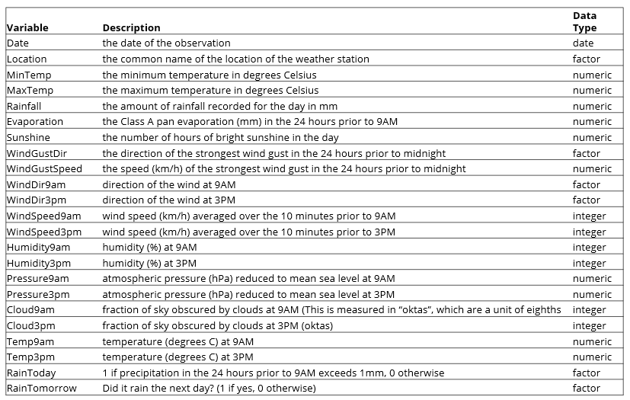
EDA: Data Definitions

Slide 4
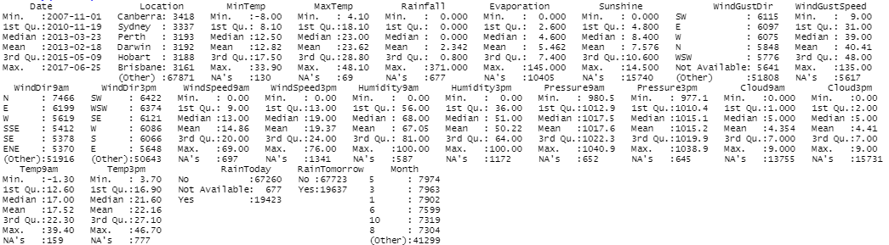
EDA: Summary of the Data
87360 Total Observations. 24 variables (16 numeric, 8 categorical)

Slide 5
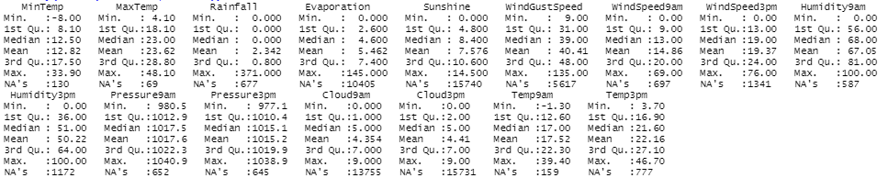
EDA: Summary of the Data
16 numeric variables
Prominent Missing Data within Sunshine, Cloud3pm, Cloud9am, Evaporation, WindGustSpeed
Positively Skewed Variables: Rainfall, Evaporation, WindGustSpeed, WindSpeed9am
Negatively Skewed Variables: Sunshine
Some outliers, but none so extreme that it could be considered bad data and be removed

Slide 6
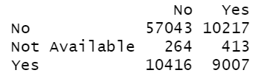
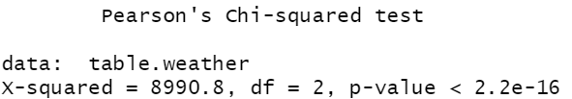
EDA: Relationship between RainToday and RainTomorrow
Two-Way Contingency Table
Chi-Square Test
The null hypothesis is that there is no relationship between RainToday and RainTomorrow.
However, since the Two-Way Contingency Table and Chi-Square Test show a p-value of less than 0.05, then we reject the null hypothesis and conclude that there is a relationship between RainToday and RainTomorrow. These two variables are dependent.
Therefore, whether it rains today might be a useful predictor for if it rains tomorrow.

Slide 7
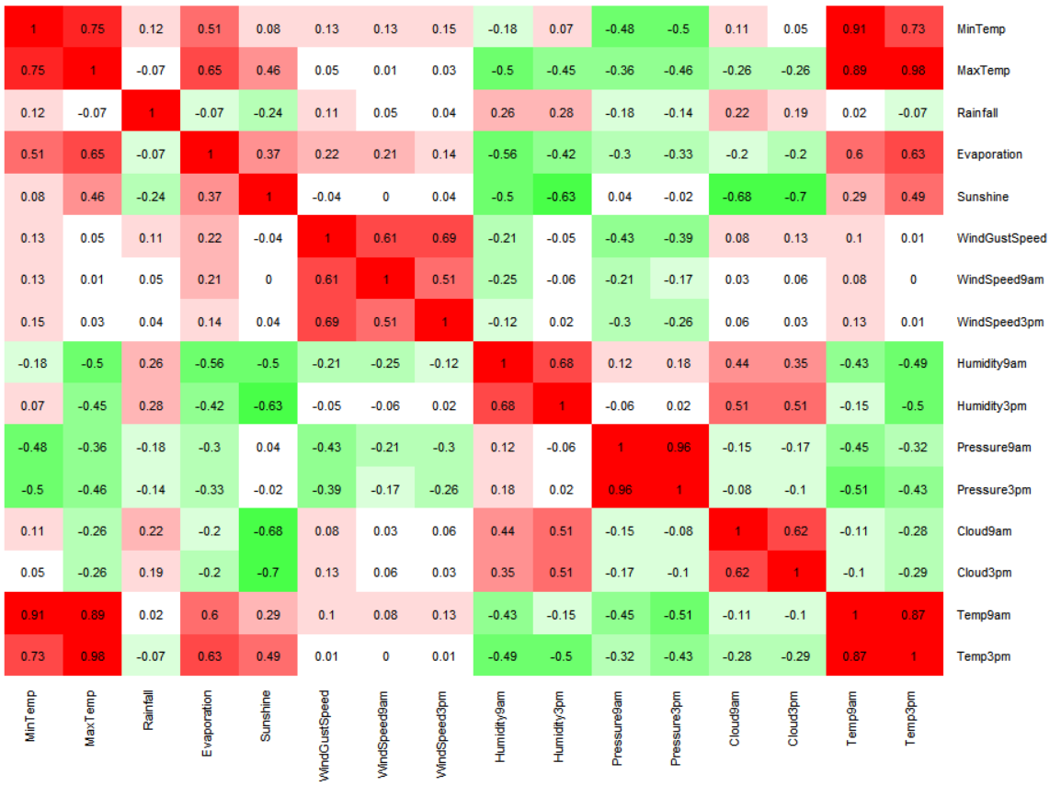
EDA: Correlation Matrix
Strong Positive Correlations:
MinTemp with MaxTemp, Temp9am, and Temp3pm
MaxTemp with Temp9am and Temp3pm
Pressure9am with Pressure3pm
Temp9am with Temp3pm
Strong Negative Correlations:
Sunshine and Cloud3pm.
Multicollinearity:
MaxTemp and Temp3pm
Pressure9am and Pressure3pm

Slide 8
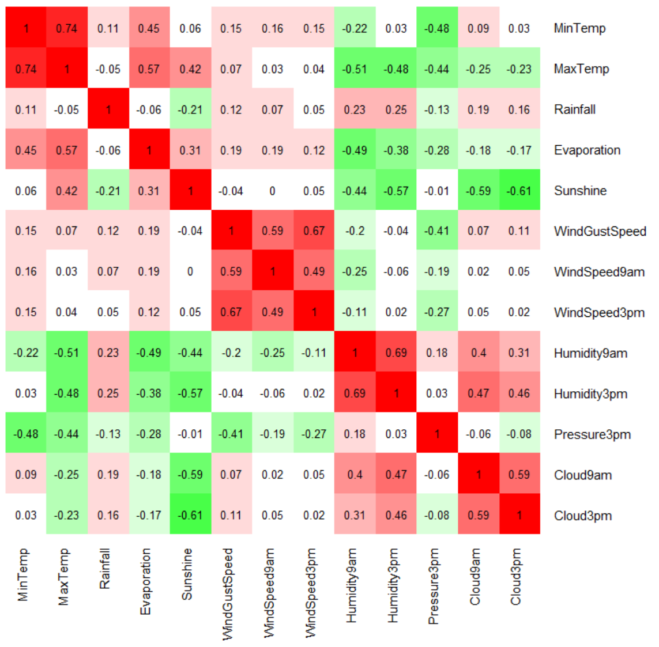
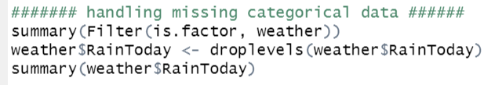
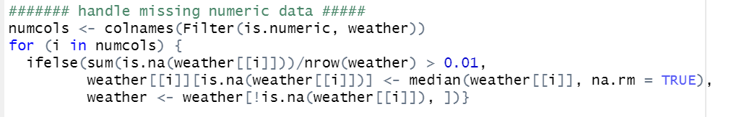
Pre-Processing Data
In order to reduce multicollinearity, the variables Temp9am, Temp3pm, and Pressure9am were removed from the data set. Now there are no relationships with a correlation stronger than .75 in this new correlation matrix.
In addition, blank records were deleted from the data set.

Slide 9
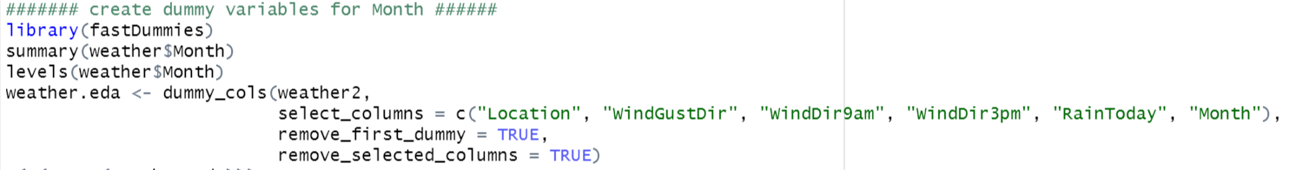
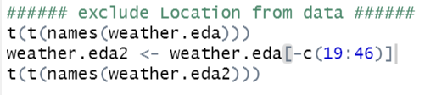
Pre-Processing Data
Dummy variables were created for the variables Location, WindGustDir, WindDir9am, WindDir3pm, RainToday, and Month.
Per the directions, all locations were removed from the data set.

Slide 10
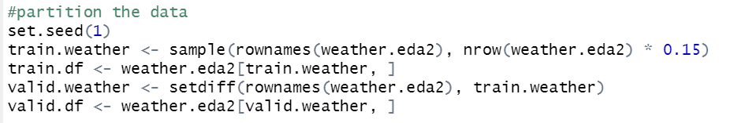
Partitioning the Data
The training and validation sets were created from the model by training the model on 15% of the data. The validation set will evaluate the model with the remaining 85% of the data.

Slide 11
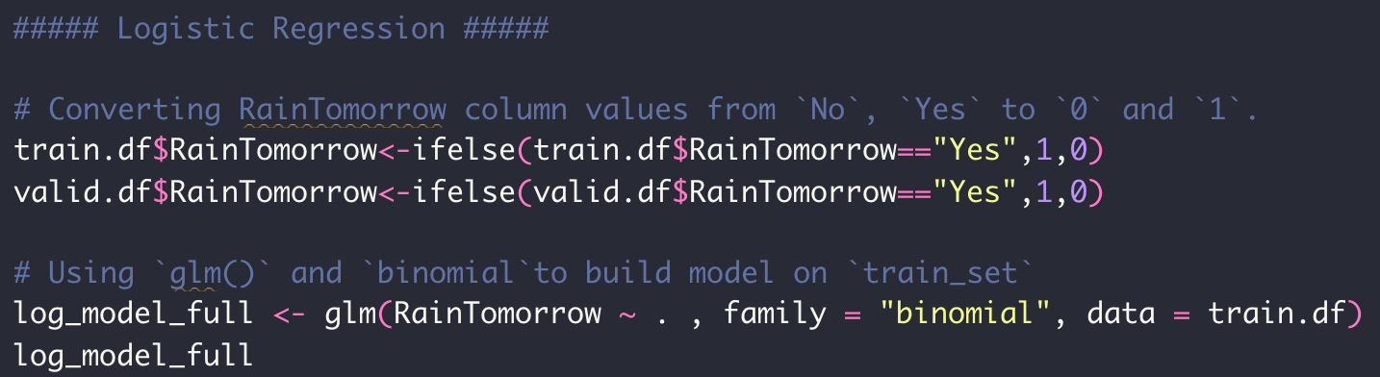
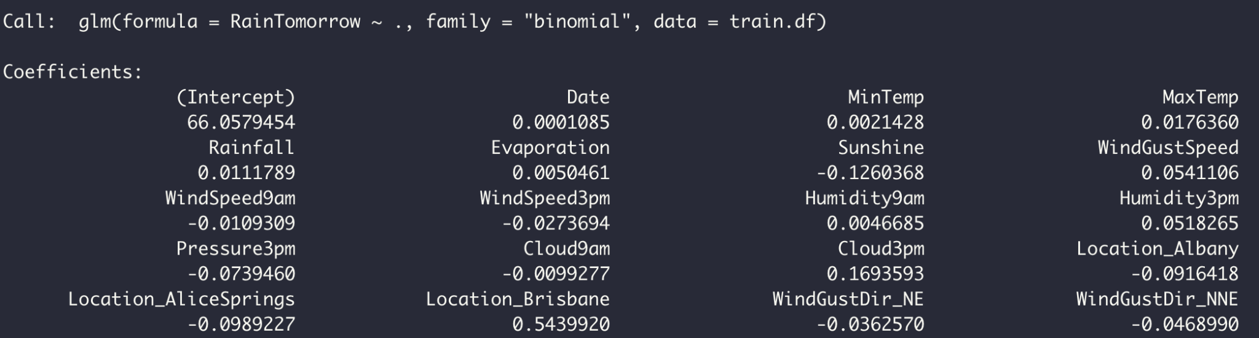
Logistic Regression
Below are the first 14 coefficients of the full logit model using `glm()` function with `binomial` method

Slide 12
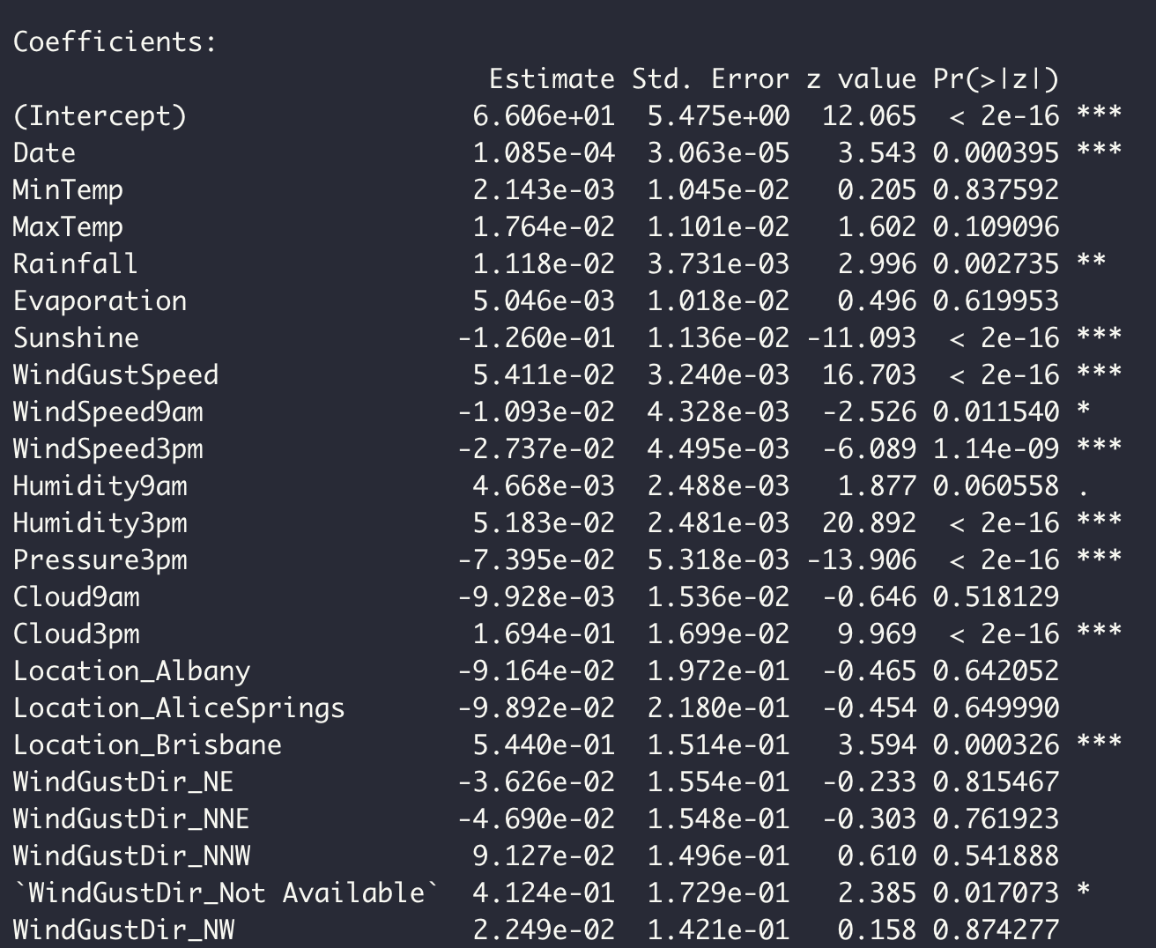
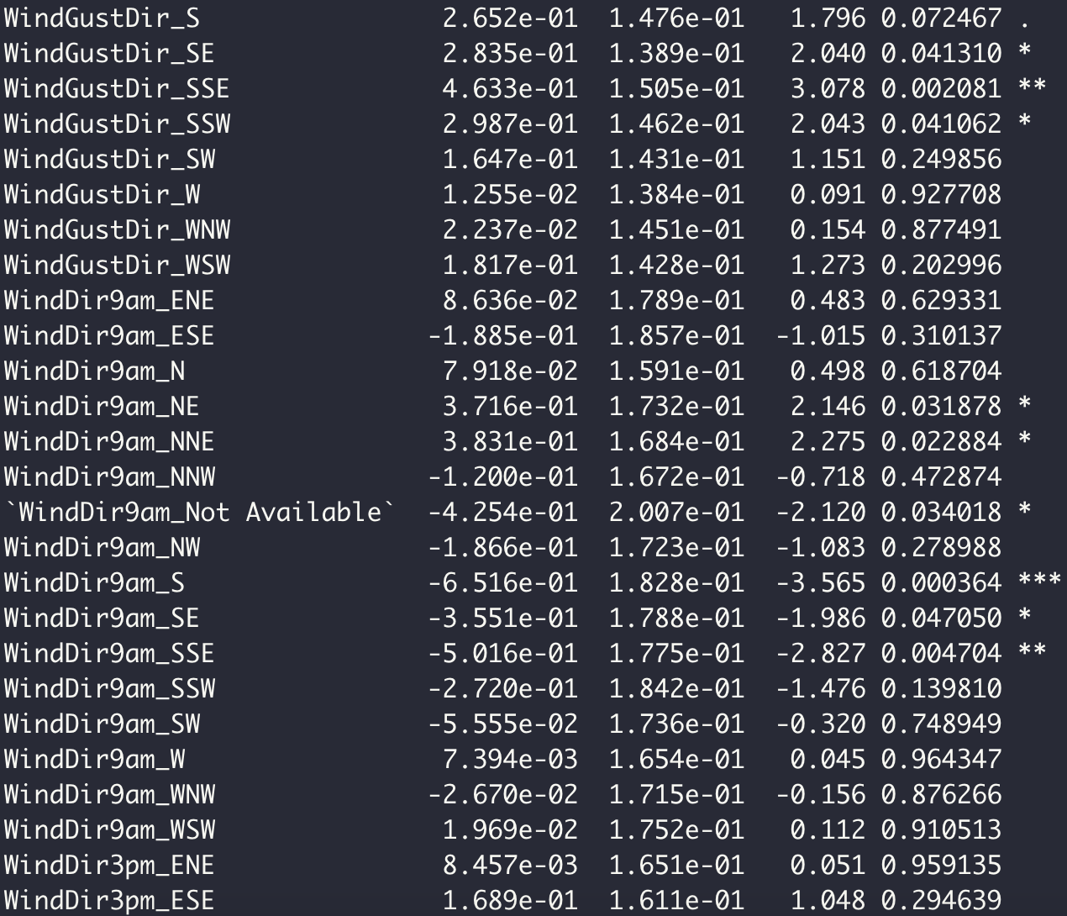
Logistic Regression
Significance of predictors at 95% confidence level
The list of non-significant predictors: MinTemp, MaxTemp, Evaporation, Humidity3pm, Cloud9am, Location_Albany, Location_AliceSprings, WindGustDir of NE, NNE, NNW, NW, S, SW, W, WNW, WSW, ENE, ESE, N, and NNW, and most of the WindDir9am.

Slide 13
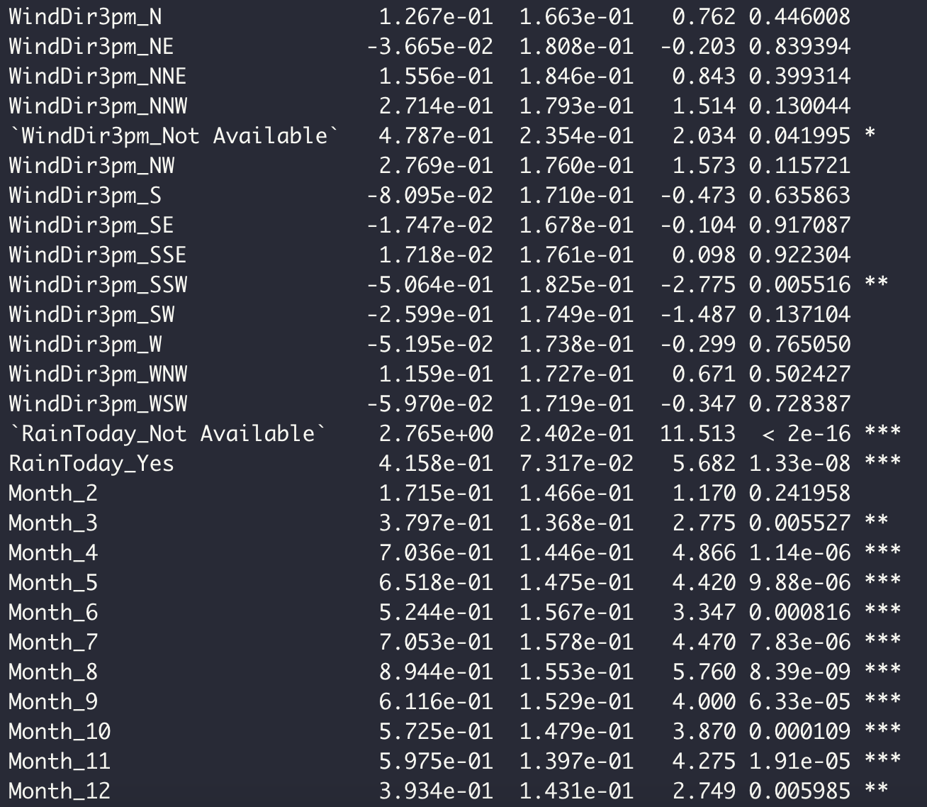
Logistic Regression
Significance of predictors at 95% confidence level
The list of non-significant predictors: WindDir3pm of N, NE, NNE, NNW, NW, S, SE, SSE, SW, W, WNW, and WSW, RainToday_Yes.

Slide 14
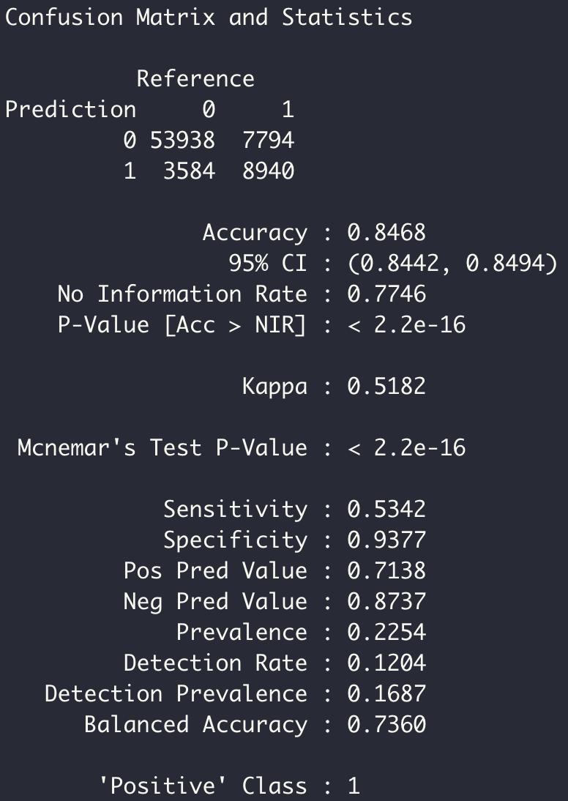
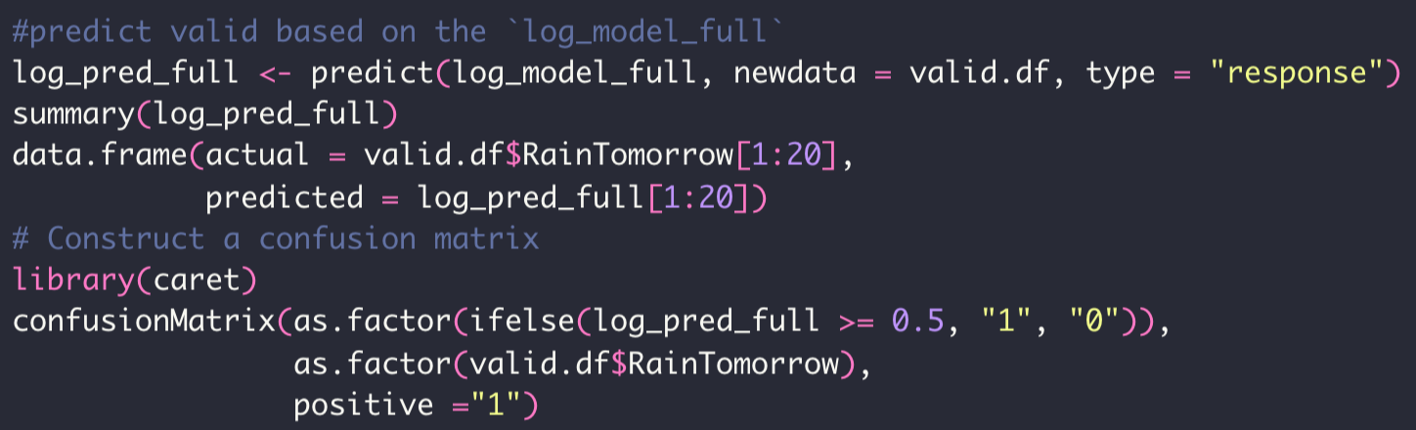
Logistic Regression
Confusion matrix on predicted results
Construct the confusion matrix with the threshold of 0.5 resulting in 84.59% accuracy accompanies with 53.42% sensitivity and 93.77% specificity.
The 0.5 cut-off is significantly efficient in detecting the day with no rain, but the sensitivity should be more focused on, since bringing an umbrella is more comfortable than getting wet.

Slide 15
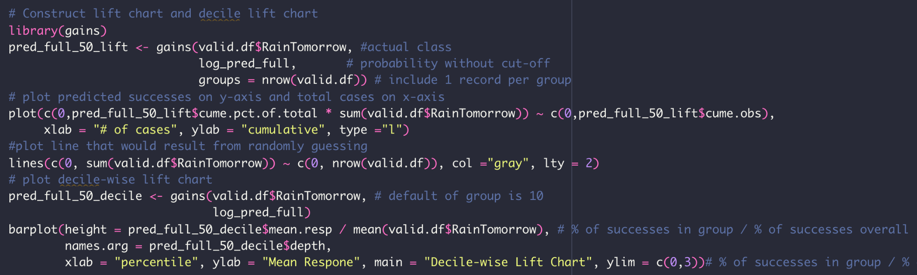
Logistic Regression
Lift chart and Decile-wise lift chart on predicted results
Using the `gains` package and `gains` function to create lift chart and decile-wise lift chart

Slide 16
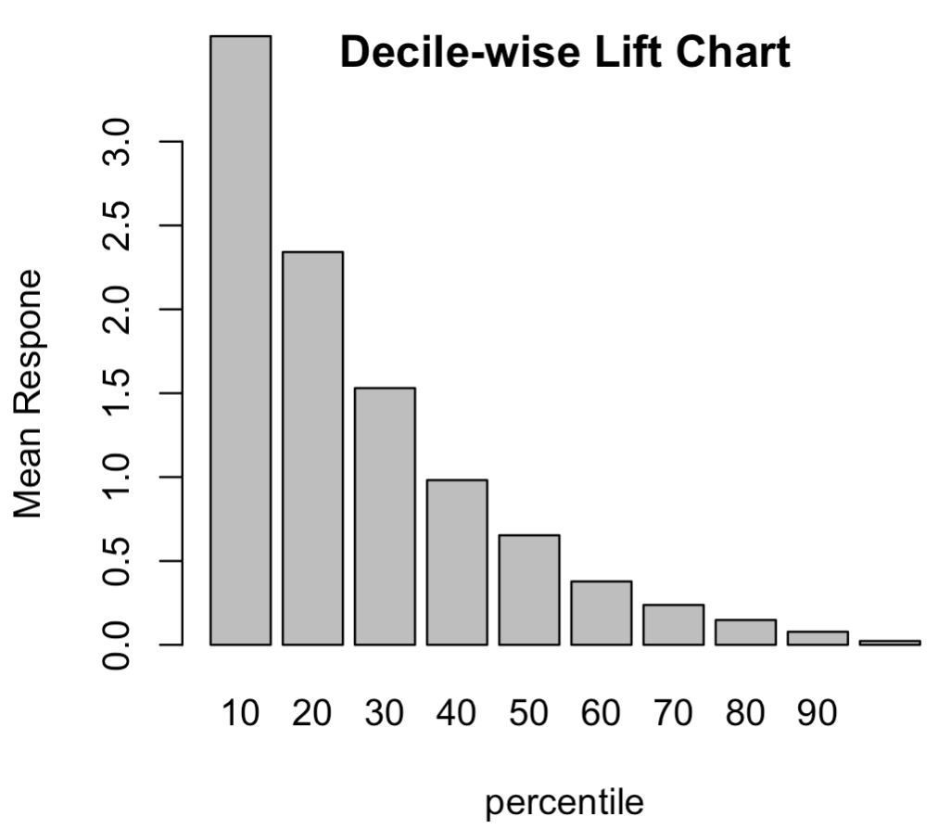
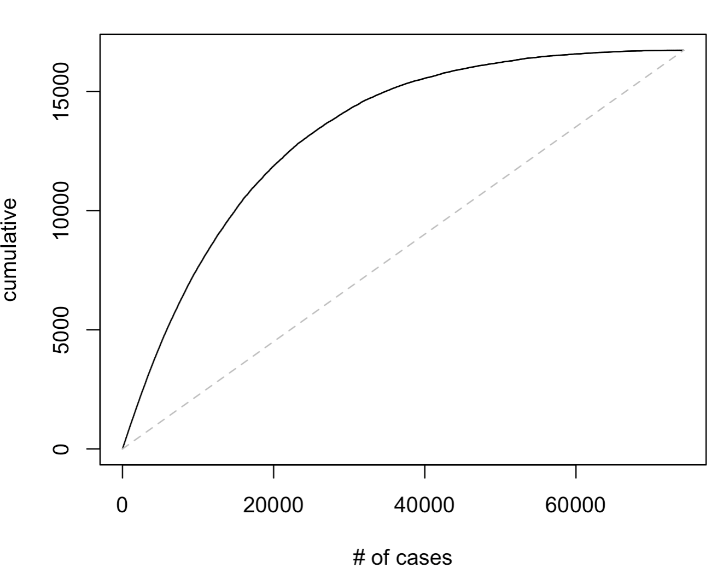
Logistic Regression
Lift chart and Decile-wise lift chart on predicted results
The chart shows us that if we selected the 40,000 most likely rainy days based on this model, we would correctly identify 1500 of them.
If we randomly classified 40,000 tomorrow day with rain, we would only be right for 750 days
The top 10% of most likely 1s will generate 4 times as many corrected 1s than randomly selecting.
The proportion is 2.3, 1.5 respectively for the top 20% and 30%
The percentile 40 performs as the same level as randomly choosing, and the bottom half of our full model more poorly than random classifying

Slide 17
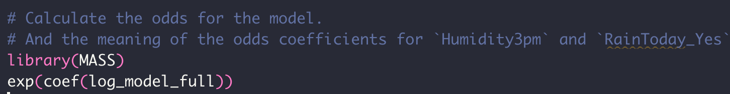
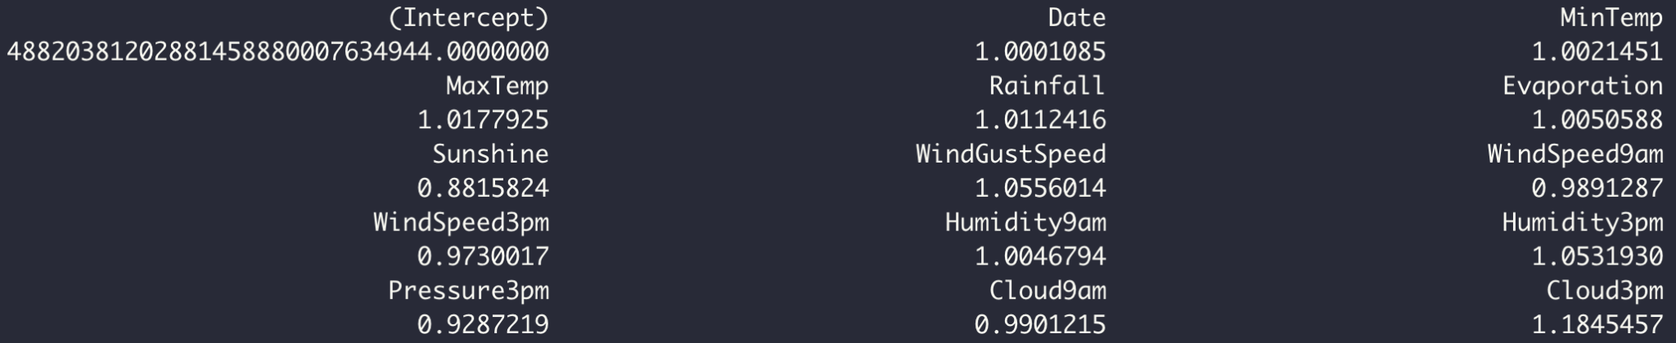
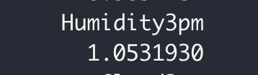
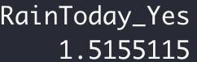
Logistic Regression
Holding the all predictors at constant value except the Humidity3pm, the probability of getting rain tomorrow over the probability of a dry day tomorrow is 1.05
Holding the all predictors at constant value except the RainToday_Yes, the probability of getting rain tomorrow over the probability of a dry day tomorrow is 1.52.

Slide 18
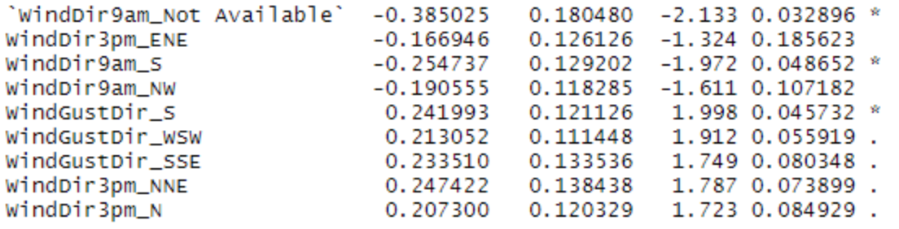
Finding The Best Reduced Models
First, the selection process was carried out with no removal of any predictors. However, it is visibly noticeable that the WindGustDir, WindDir9am and WindDir3pm carries the least significance. Therefore, to find the best model, they were removed.
( Above is a sample table of significance of the WindGustDir, WindDir9am and WindDir3pm predictors from forward selection )
Removal Code:
train.df = subset(train.df, select = -c(19:63))
valid.df = subset(valid.df, select = -c(19:63))

Slide 19
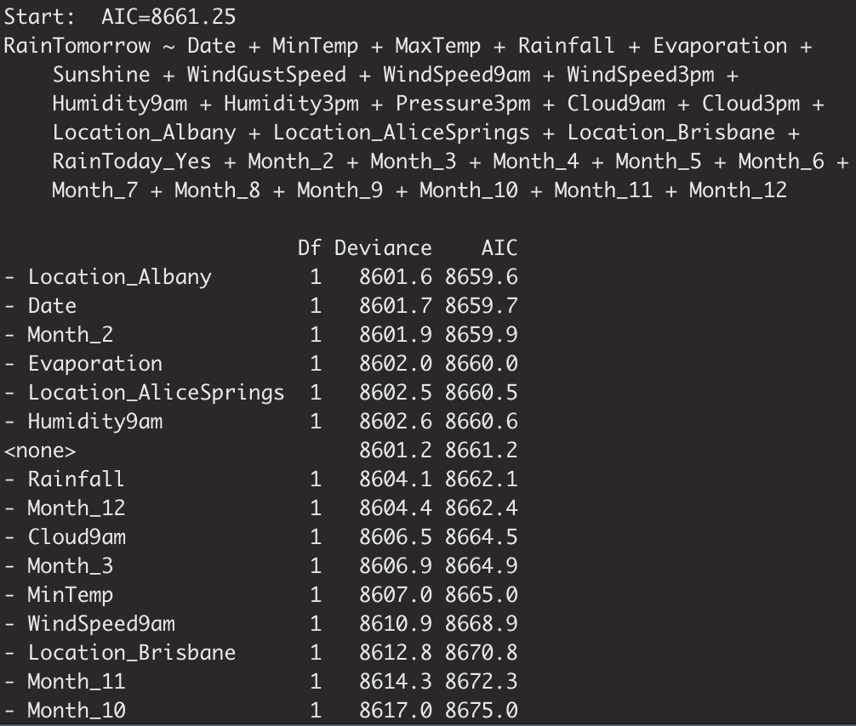
Two Variable Selection Methods to Find Good Reduced Models:
Backwards Elimination
Starts with all predictors with an AIC of 8661.25

Slide 20
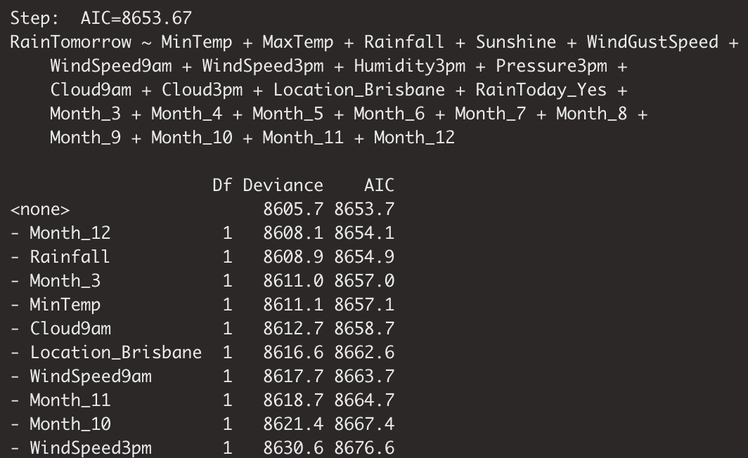
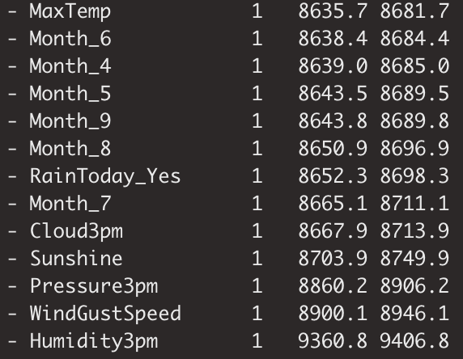
Backwards Elimination
The last best predictor to keep is Month_12 with the AIC score of 8653.67

Slide 21
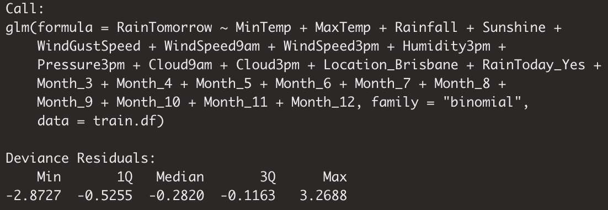
Backwards Elimination Results

Slide 22
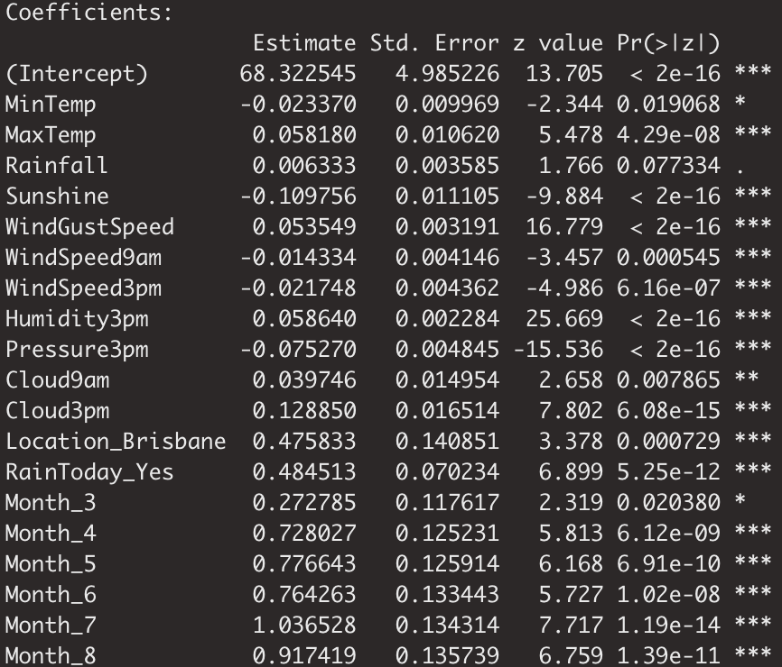
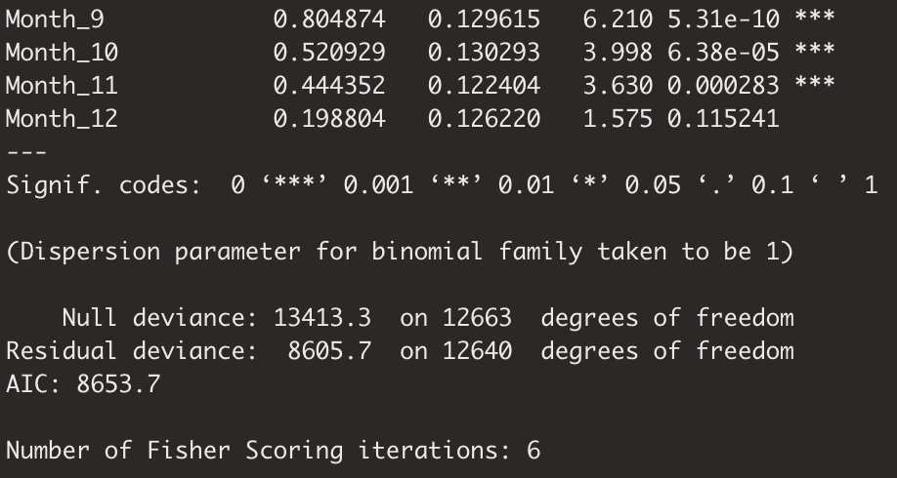
Backwards Elimination Variable Significance

Slide 23
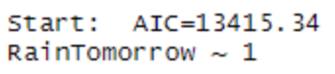
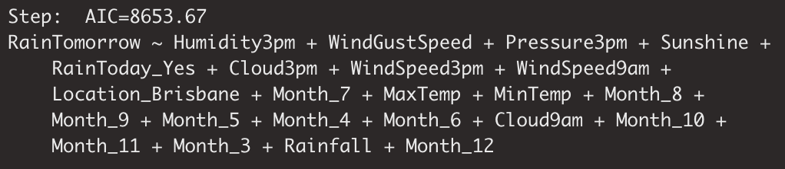
Stepwise Regression
Stepwise Regression starts with an empty model with an AIC of 13415.34.
Similar to Backwards Elimination, it stops at an AIC of 8653.67 with Month_12 being the last best predictor to add

Slide 24
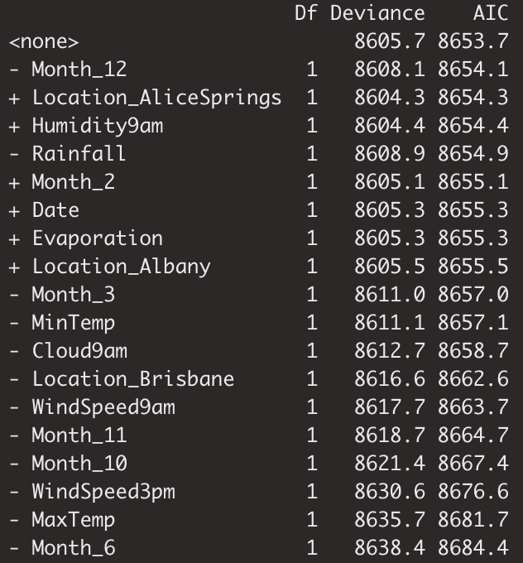
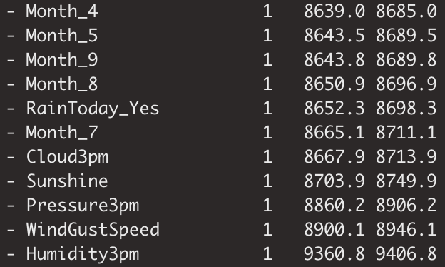
Stepwise Regression

Slide 25
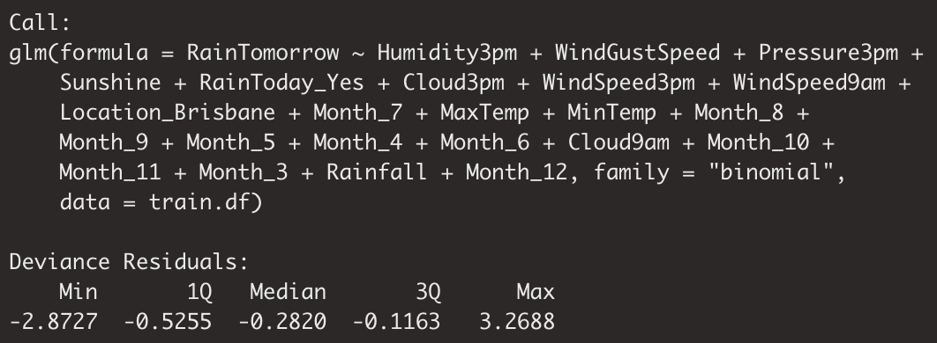
Stepwise Regression Results

Slide 26
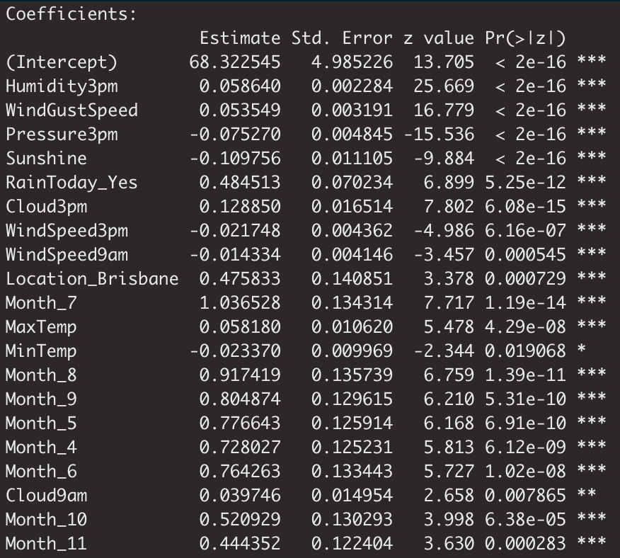
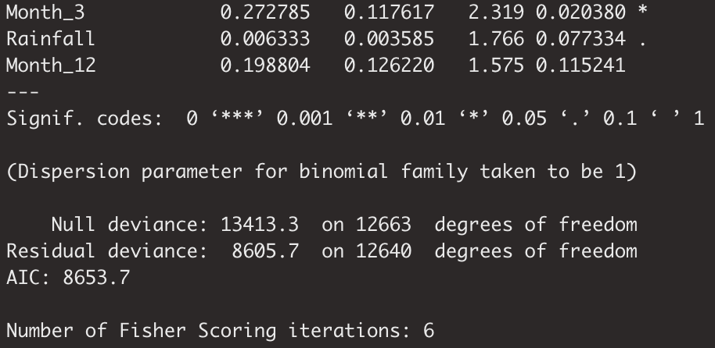
Stepwise Regression Variable Significance

Slide 27
Best Model
As with Backwards Elimination, Stepwise Regression also shows a 18-predictor model as the best model with an AIC of 8653.67.
Best Predictors:
Backwards Elimination - MaxTemp, Sunshine, WindGustSpeed, WindSpeed9am, WindSpeed3pm, Humidity3pm, Pressure3pm, Cloud3pm, Location_Brisbane, RainToday_Yes, Month_4, Month_5, Month_6, Month_7, Month_8, Month_9, Month_10, Month_11
Stepwise Regression - Humidity3pm, WindGustSpeed, Pressure3pm, Sunshine, RainToday_Yes, Cloud3pm, WindSpeed3pm, WindSpeed9am, Location_Brisbane, Month_7, MaxTemp, Month_8, Month_9, Month_5, Month_4, Month_6, Month_10, Month_11
Compared to backwards elimination, stepwise tended to add the most useful predictors first.
Overall, because we see that RainToday_Yes is a significant predictor in both selection methods, we can say RainToday is a useful predictor for whether it rains tomorrow.

Slide 28
Appendix
Just to double check our work, to see which selection methods should be chosen as our top two, forward selection also took place.

Slide 29
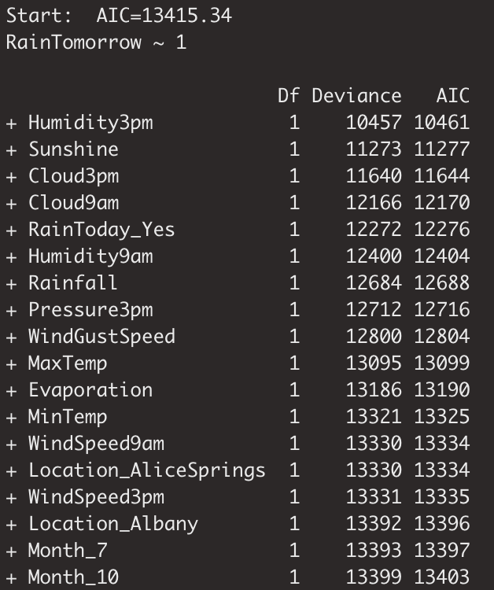
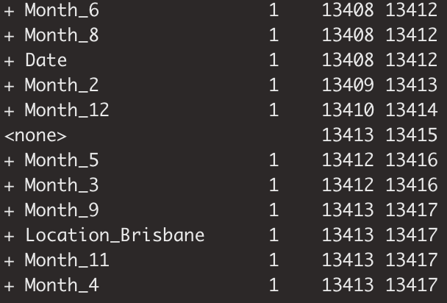
Forward Selection - Start
Our forward selection starts with an empty model with an AIC of 13415.34

Slide 30
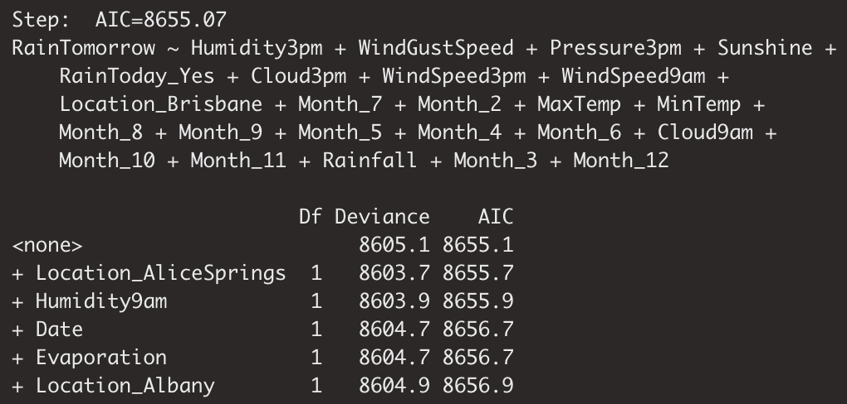
Forward Selection - End
It continues to add more variables, with Month_12 being the last best predictor to add to the model. The lowest AIC score from forward selection is 8655.07

Slide 31
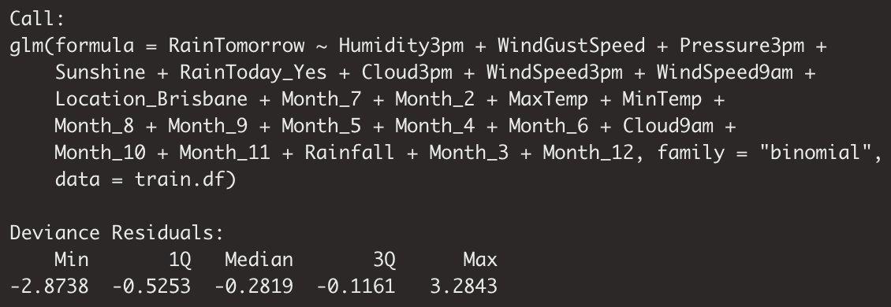
Forward Selection Results

Slide 32
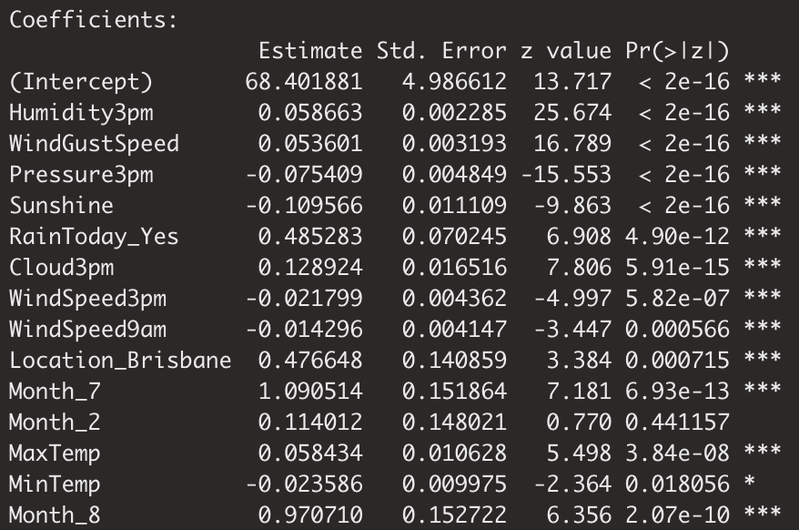
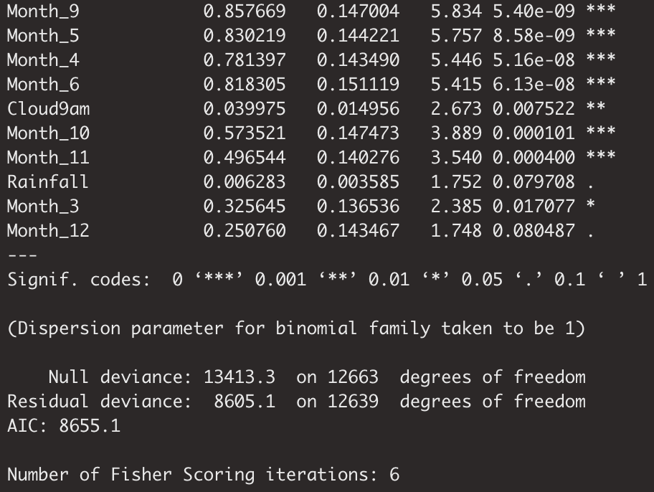
Forward Selection Variable Significance

Slide 33
Forward Selection Best Model
From forward selection, our best model is also a 18-predictor model with an AIC of 8655.07.
Compared to Backward Elimination and Stepwise Regression, Forward Selection has the highest AIC, which leaves Backward Elimination and Stepwise Regression to be our best variable selection methods.

Slide 34
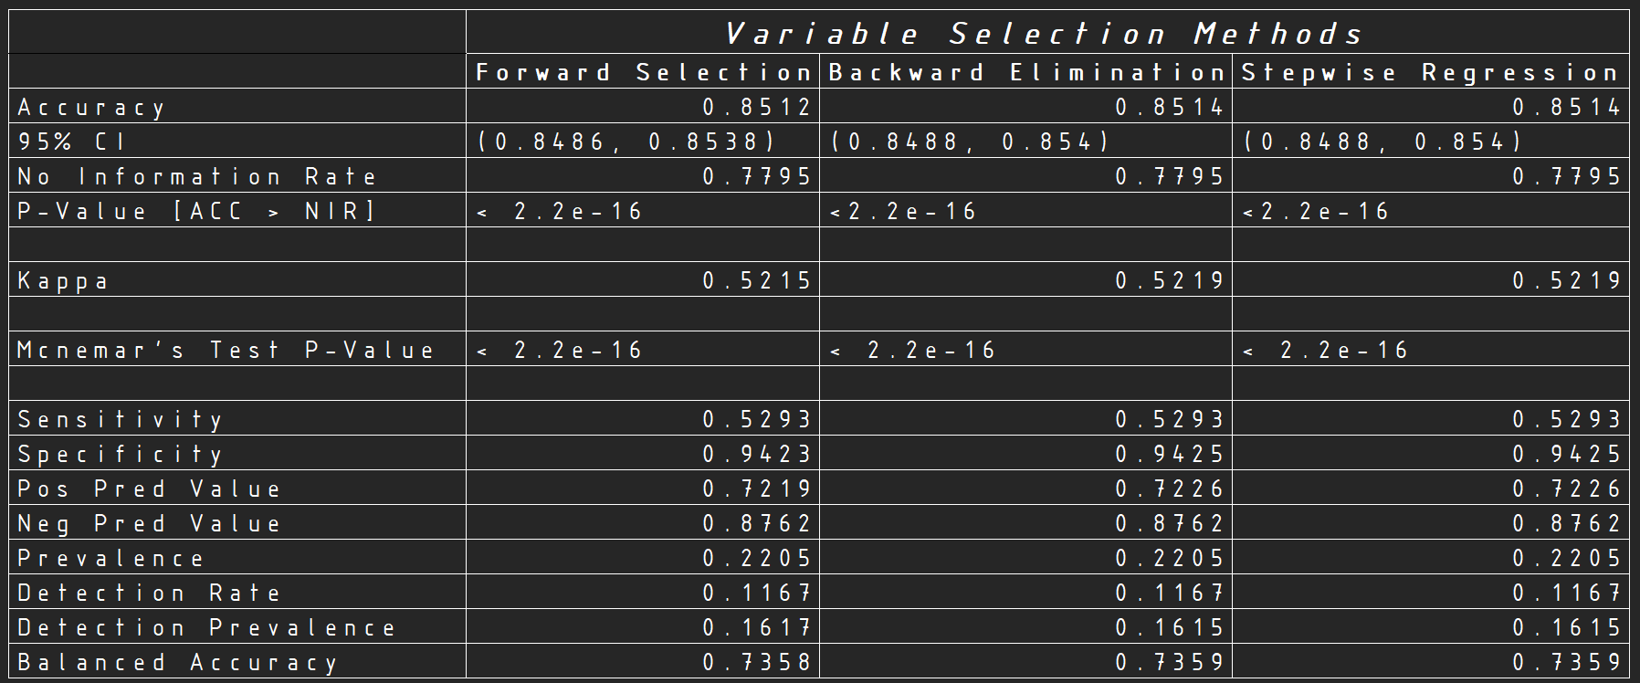
Comparison Table and Conclusions

Slide 35
Comparison Table and Conclusions
The Comparison Table shows that both Stepwise Regression and Backward Elimination have slightly higher Accuracy, Kappa, and Adjusted Accuracy than Forward Selection.
All metrics including AIC are the same for both Stepwise Regression and Backward elimination.
In conclusion, while Stepwise Regression added the most significant variables first, and has one of the best classification performance overall, Backward Elimination provides us with the best model because it has the lowest AIC from the start to end of the elimination process.

Slide 36
R Champions
Omar Ahmouda, Leona Bell, Helen Chu, Hoai Do, Delaney Smith
BANA 4080 - Homework 3
Australian Weather Data

